Slide 1
January 21, 2026
Pumper Workshop #5
Projections: Engineering Survey and Report

Slide 2

Budget Workshop Series
☑ | Budget WS#1 | Understanding Water Purchases | August 28, 2025
☑ | Budget WS#2 | WRD 101 | October 1
☑ | Budget WS#3 | Capital Improvement Program | October 23
☑ | Budget WS#4 | Pumper Projections | December 17
 | Budget WS#5 | Projections: Engineering Survey Report | January 21, 2026
☐ | Budget WS#6 | Midyear Budget Review | February 26
Notes:
Thank you for attending our fifth workshop where we will be presenting the key components considered when preparing our annual Engineering Survey and Report.
It's hard to believe that it's been almost five months since we started the budget workshops – we hope the journey has been informative!
As a reminder, we have one more workshop scheduled for February 26th. This will be the kickoff to our budget discussion as we start discussing next years Replenishment Assessment (RA).
So, again thank you for attending and now we’ll turn it over to Brian Partington, our Manager of Hydrogeology.

Slide 3
Why do we prepare the ESR?
Prepared annually per California Water Code (§60300 & §60350)
Documents the actuals for Previous Year, provides an estimate for Current Year, and a projection for Ensuing Year.
Establishes quantity of water needed to balance basin pumping and for decades has been based on long-term averages, modeled by the USGS.
This approach results in less variability in the replenishment assessment (avoids spiking) and allows for a more predictable, steady increase to cover the consistent rising cost of purchasing water (WTR).
Notes:
PARAPHRASE…

Slide 4



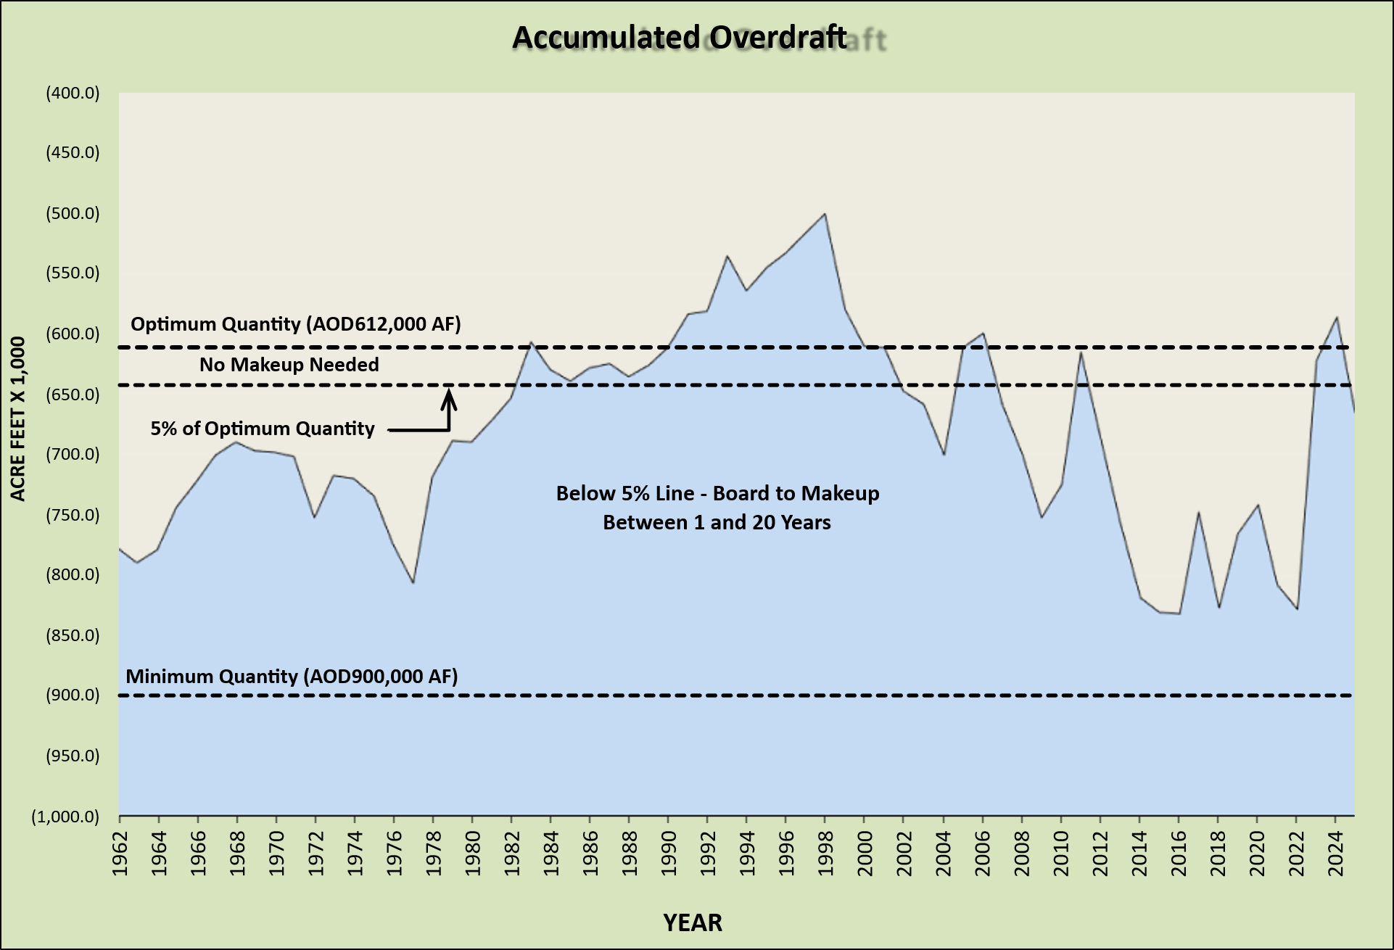

Five key steps when preparing the ESR
Todays Presentation Covers Steps 1 - 3
Sneak Peek at
Water Purchase Rates
Under Review
(See Workshop #1)
Step 1
Evaluate Rainfall Data
Step 2
Estimate Production
Step 3
Estimate Replenishment
Step 4
Accumulated Overdraft
Step 5
Replenishment Cost Estimate
$$$
Notes:
Walk through steps…today’s presentation will cover Step 1 – 3. We’re still working on Step #4, and we’ll give you a sneak peek at the rates for Step #5.

Slide 5
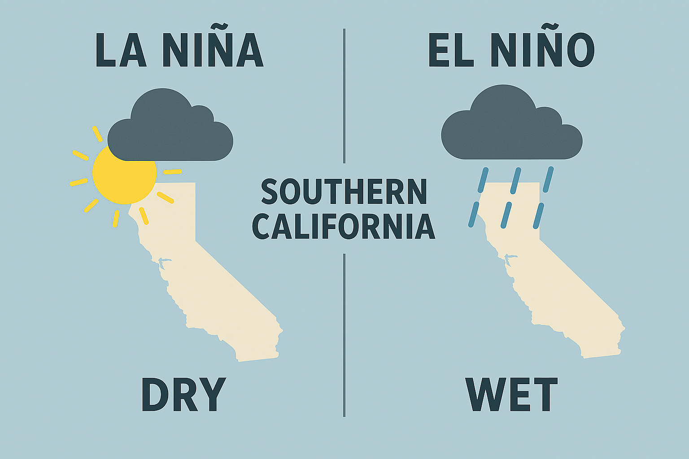

Step 1: Evaluating Rainfall Data, Weather Patterns
What affects the amount of rainfall we typically receive in any given year?
Notes:
The first step is to evaluate rainfall, which generally starts around October.
By now most everyone knows our weather patterns are primarily controlled by La Nina’s (generally dry) and El Nino’s (generally wet).

Slide 6
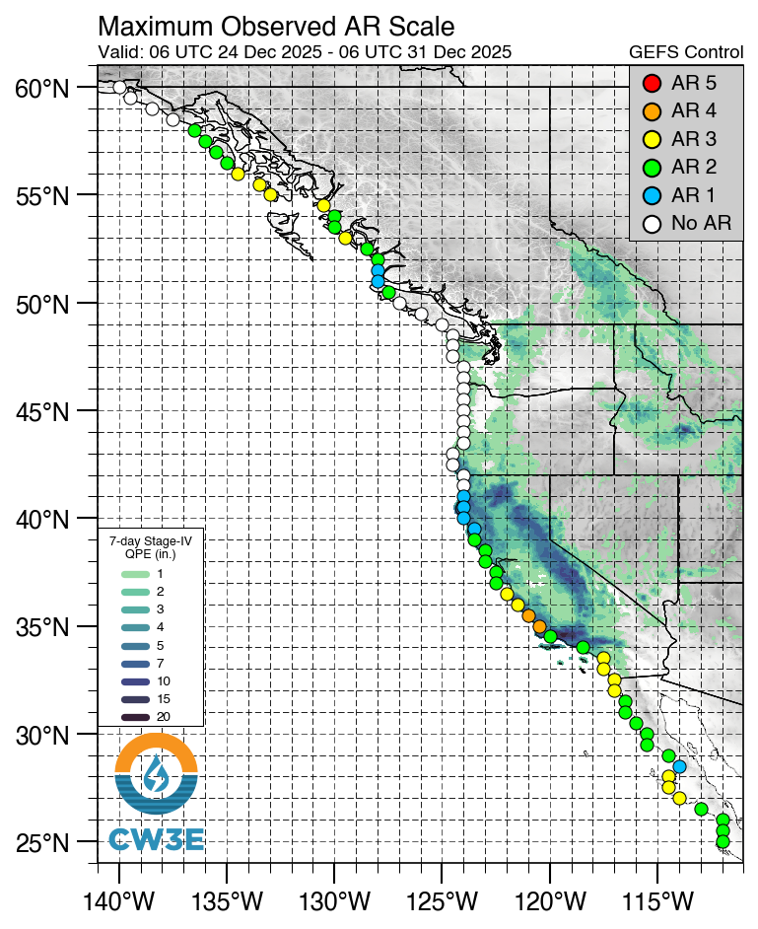
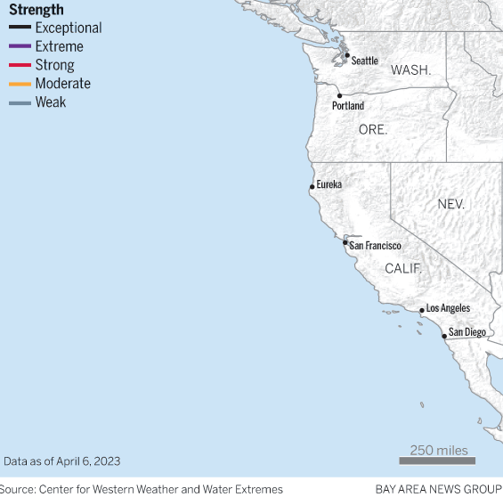
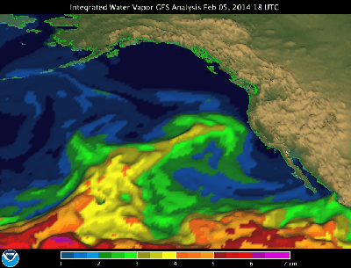
Step 1: Evaluating Rainfall Data, Weather Patterns
Atmospheric rivers tracked closely as reported by CW3E.
Notes:
We also track atmospheric rivers that dominate the rainfall we receive along the western coastal US.
Here are a few examples how the data is tracked and presented by the Center for Western Weather and Water Extremes (CW3E).

Slide 7
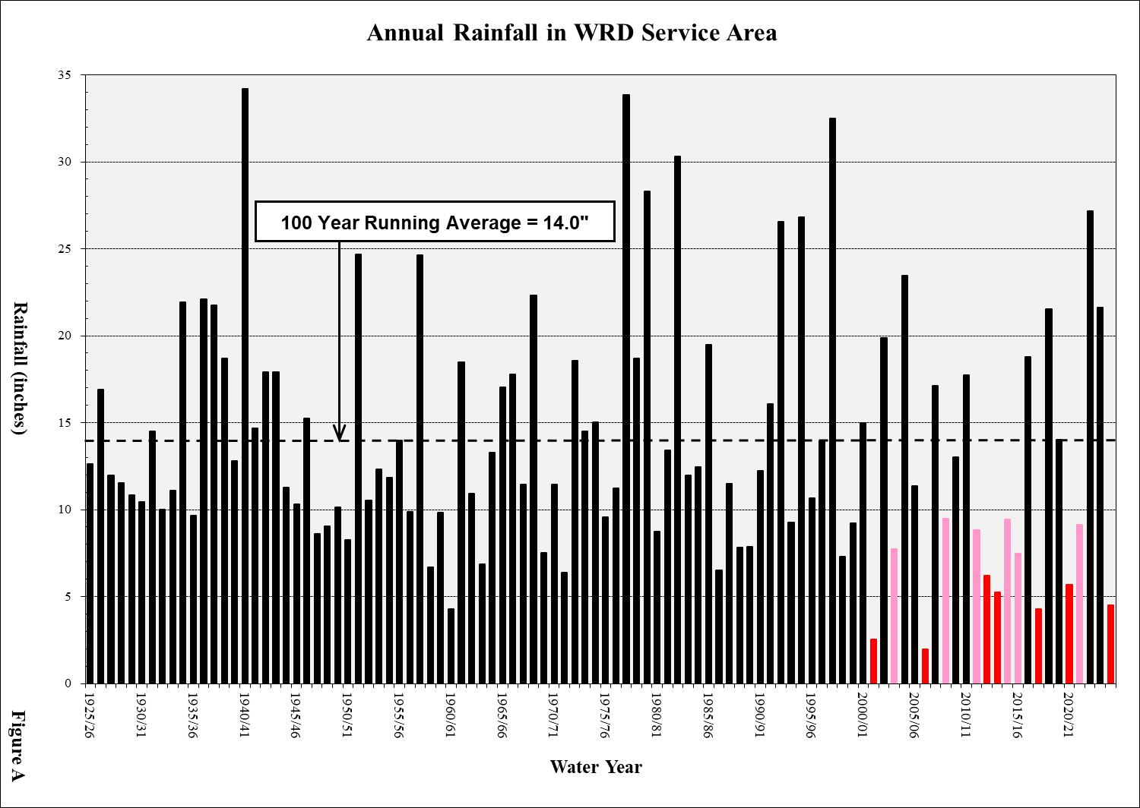
Step 1: Evaluating Rainfall Data, Historical Record
Drought a real concern for our Region. In WY25, region only received 4.52” (32% of our local 100yr Avg.)
Notes:
In the ESR, we review and report rainfall dating back to 1925, that’s 100 year!
Over that time our annual running average rainfall is about 14”. You can see that on the horizontal dashed line…
Now, one thing that has been a concern for just over two decades now is the persistence of drought, dating back to about the late 1990s.
For example, last year we only received 4.52” of rainfall – that’s 32% of our local 100-year AVG.
We’ve also had several so-so years (shown in pink) and several really dry years (shown in red). One year we only received 1.95”.
This lack of rainfall affect us because a good portion of our basin recovery is tied to the amount of water we can capture in the Montebello Spreading Grounds.
We’ll talk more about that later, but I just wanted to underscore the importance of rainfall…

Slide 8
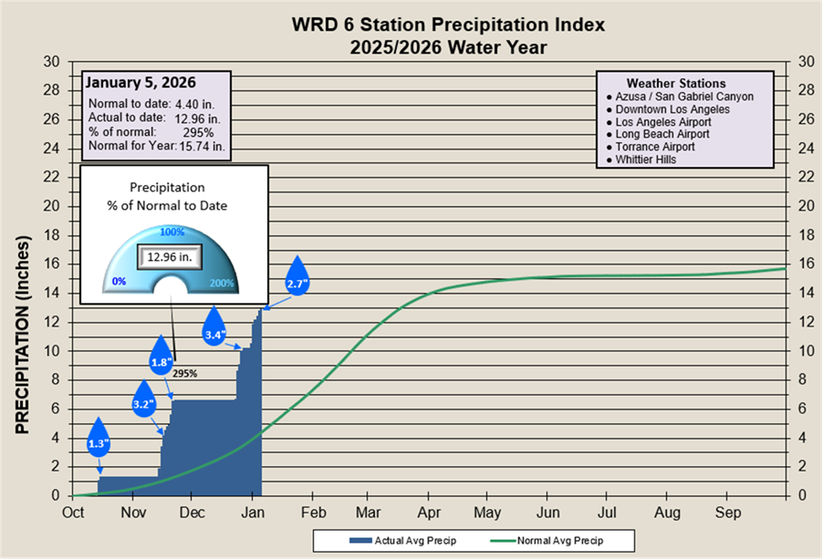
Step 1: Evaluating Rainfall Data, Tracked Closely by WRD
Good start to WY26. La Nina seems to be fading fast, though not guaranteed as we enter “Wet Months”.
Notes:
Now, enough with that doom and gloom – we’re off to a good start to WY26. So far, we’ve received nearly 13”, or 295% of NORMAL.
So, the predicted La Nina for this years seems to be fading fast, though no guaranteed – we’ll know more as we enter what we call the “Wet Months”.
We generally get most of our rainfall in January / February.

Slide 9
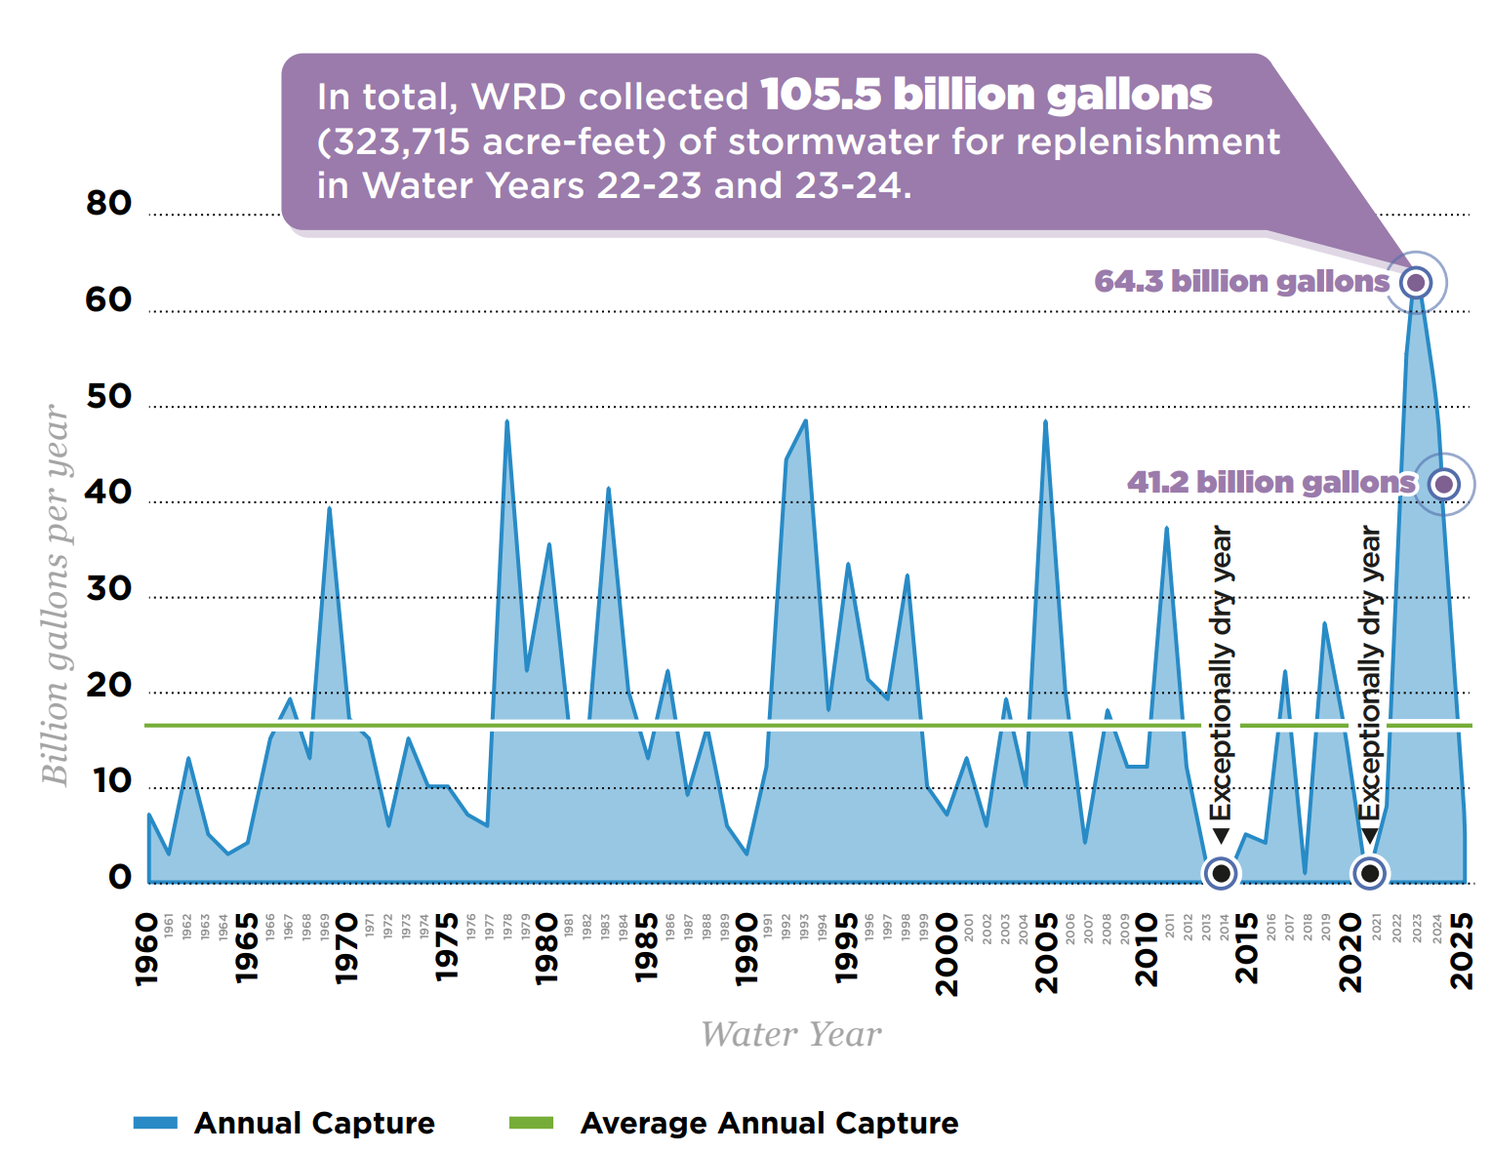
Step 1: Evaluating Rainfall Data, Recharging our Aquifers
When it rains, a significant amount of that rainfall is captured and recharged into the aquifers by LACPW.
Notes:
And just one final side to wrap up rainfall – this chart clearly shows you why rainfall is important for our region.
When it rains, a significant amount of that rainfall is captured and recharged into the aquifers by LACPW.
And most importantly…ITS FREE!

Slide 10
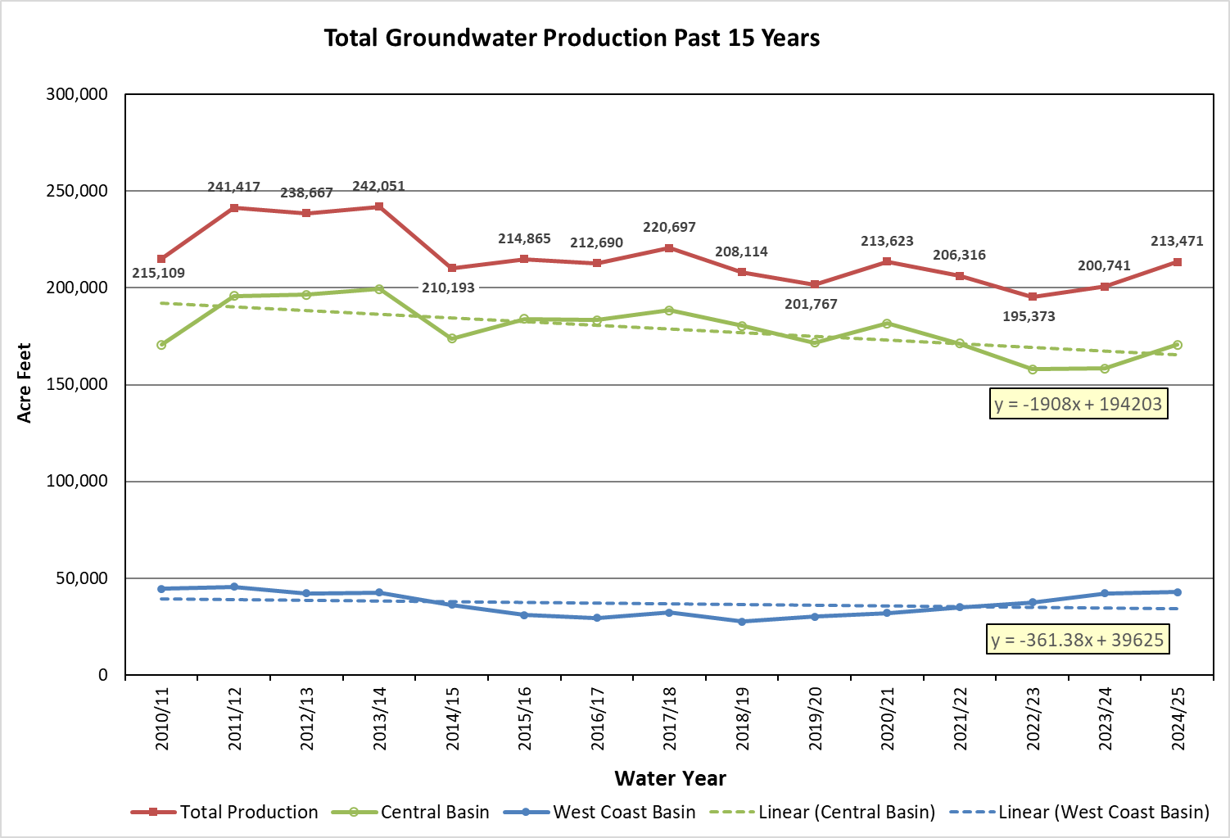
Step 2: Estimate Production, Current Trends
Total Groundwater Production Past 15 Years
Total production has been down since the recent high in WY14…
Note: Production shown above excludes In-Lieu.
Notes:
Groundwater production is the second thing we evaluate when preparing the ESR.
This chart provides production data for the past 15yrs. Its gives us a general sense of the overall trend…
As you can see, total production has been down since the recent high in WY14.
CB trendline is about -1900 AFY.
WCB trendline is about -360 AFY.
Slope-Intercept equation Y=mx+b (Algebra).

Slide 11
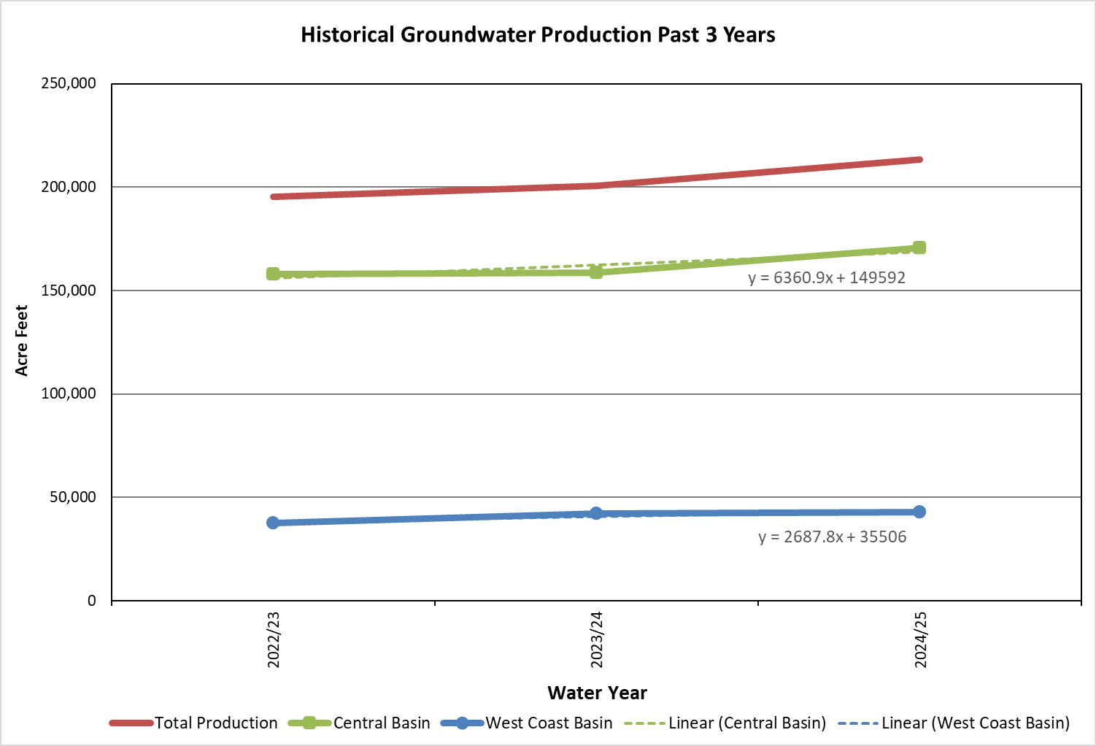
Step 2: Estimate Production, Current Trends
Total Groundwater Production Past 3 Years
However, recent total production rebounded slightly: CB (past 2yrs.) and WCB (past 7yrs.)…
Note: Production shown above excludes In-Lieu.
Notes:
We also look at more recent pumping trends – here’s the past 3 years.
CB trend is up slightly past 2yrs.
WCB trend has been consistently increasing the past 7yrs.
It's nice to see that we’re heading in the right direction…thank you!

Slide 12
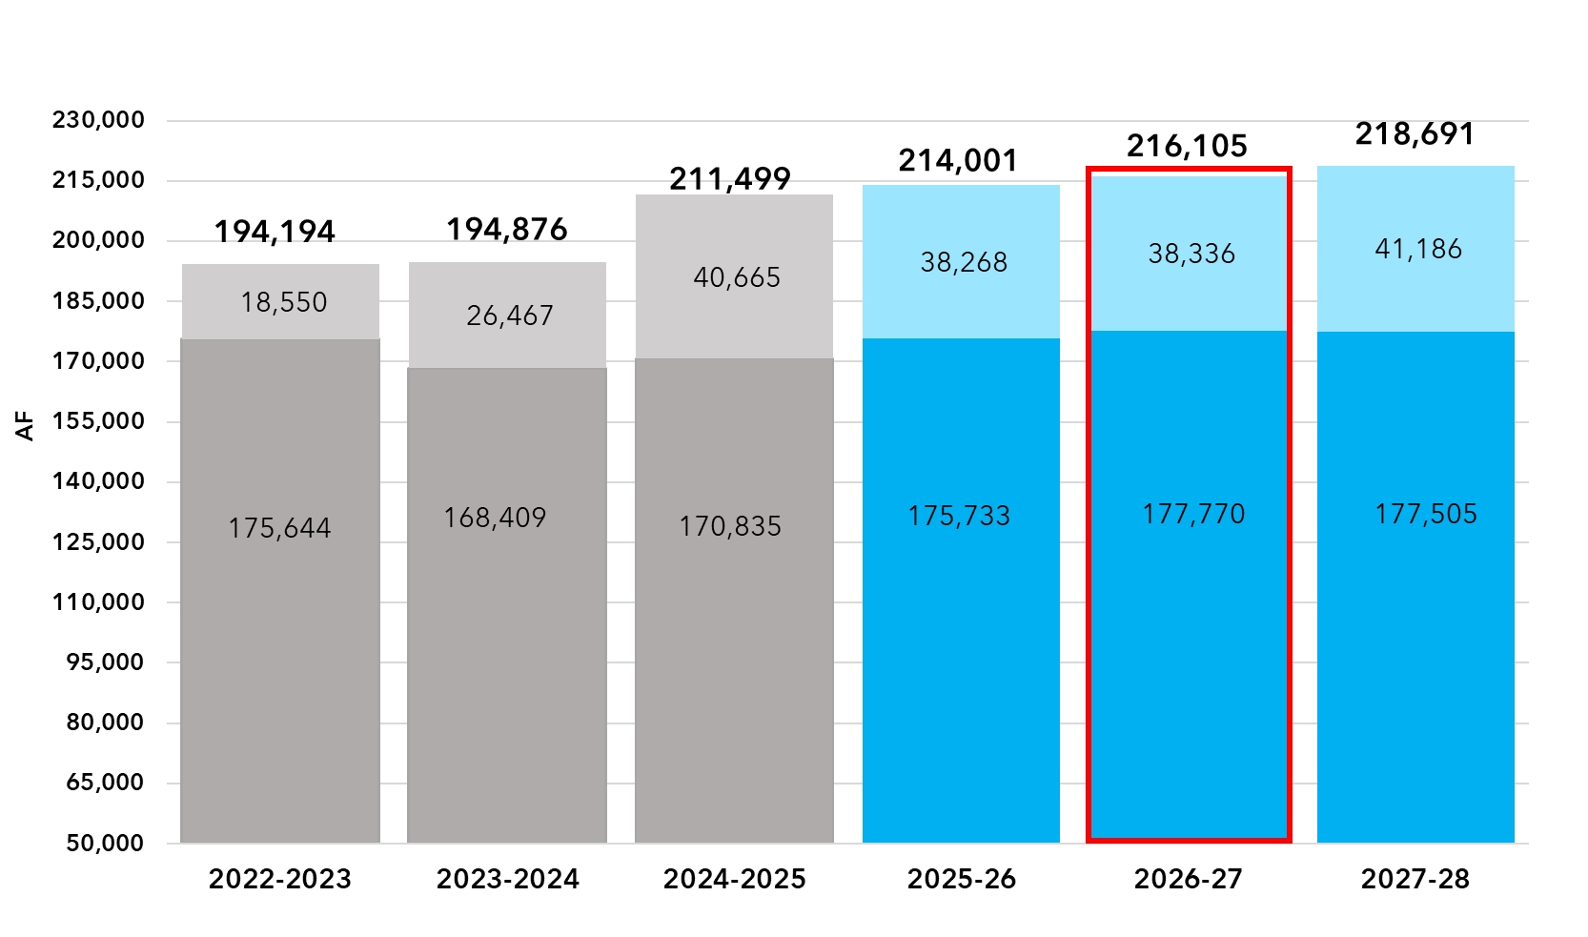
Step 2: Estimate Production, Pumper Projections
1% increase projected by pumpers for WY27. Pumper forecasts lower by ~4,000 AFY (roughly 1-3%).
(+1.18%)
(+0.98%)
Previous
Year
Current
Year
Ensuing
Year
Forecasted
200,141
-2.63%
(Nov 23)
Forecasted
214,139
-1.23%
(Nov 24)
Forecasted
219,119
-2.34%
(Nov 24)
Pumper
Projections
Pumper
Projections
Pumper
Projections
Actuals
Actuals
Actuals
Notes:
At our last workshop, Esther presented the results of the pumper projections so this should look familiar…
In the ESR, we’re required to report the Previous, Current, and Ensuing Years.
Based on pumper feedback, its anticipated there will be about a 1% increase in WY27.
Though, pumper forecasts when compared to actual pumping is on average lower by about 4,000 AFY (or 1% to 3%).

Slide 13
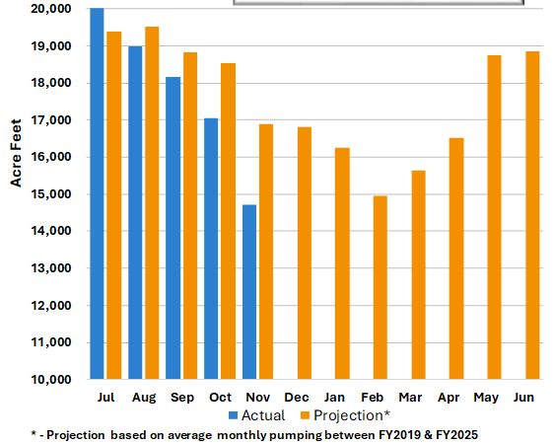
Step 2: Estimate Production, Effects of Rainfall FY26
Total production lower than seven-year average (2019 – 2025).
5% lower through November 2025 (19% lower in West Coast Basin).
Based on current rainfall and pumping trends its unlikely we will reach this year's goal of 211K AF.
  Optimist: 1% reduction is ~209K AF.
  Pessimist: 5% reduction is ~200K AF.
  Recommend: 3% reduction is ~205K AF.
Ensuing year estimate assumes normal rainfall and the current year estimate (211K AF) will increase by the pumper projected 1%.
FY27 estimate is 213,000* AF.
Production through November 2025
Notes:
And lastly, each month we present a groundwater production update at our Water Resources Committee.
PARAPHRASE…

Slide 14
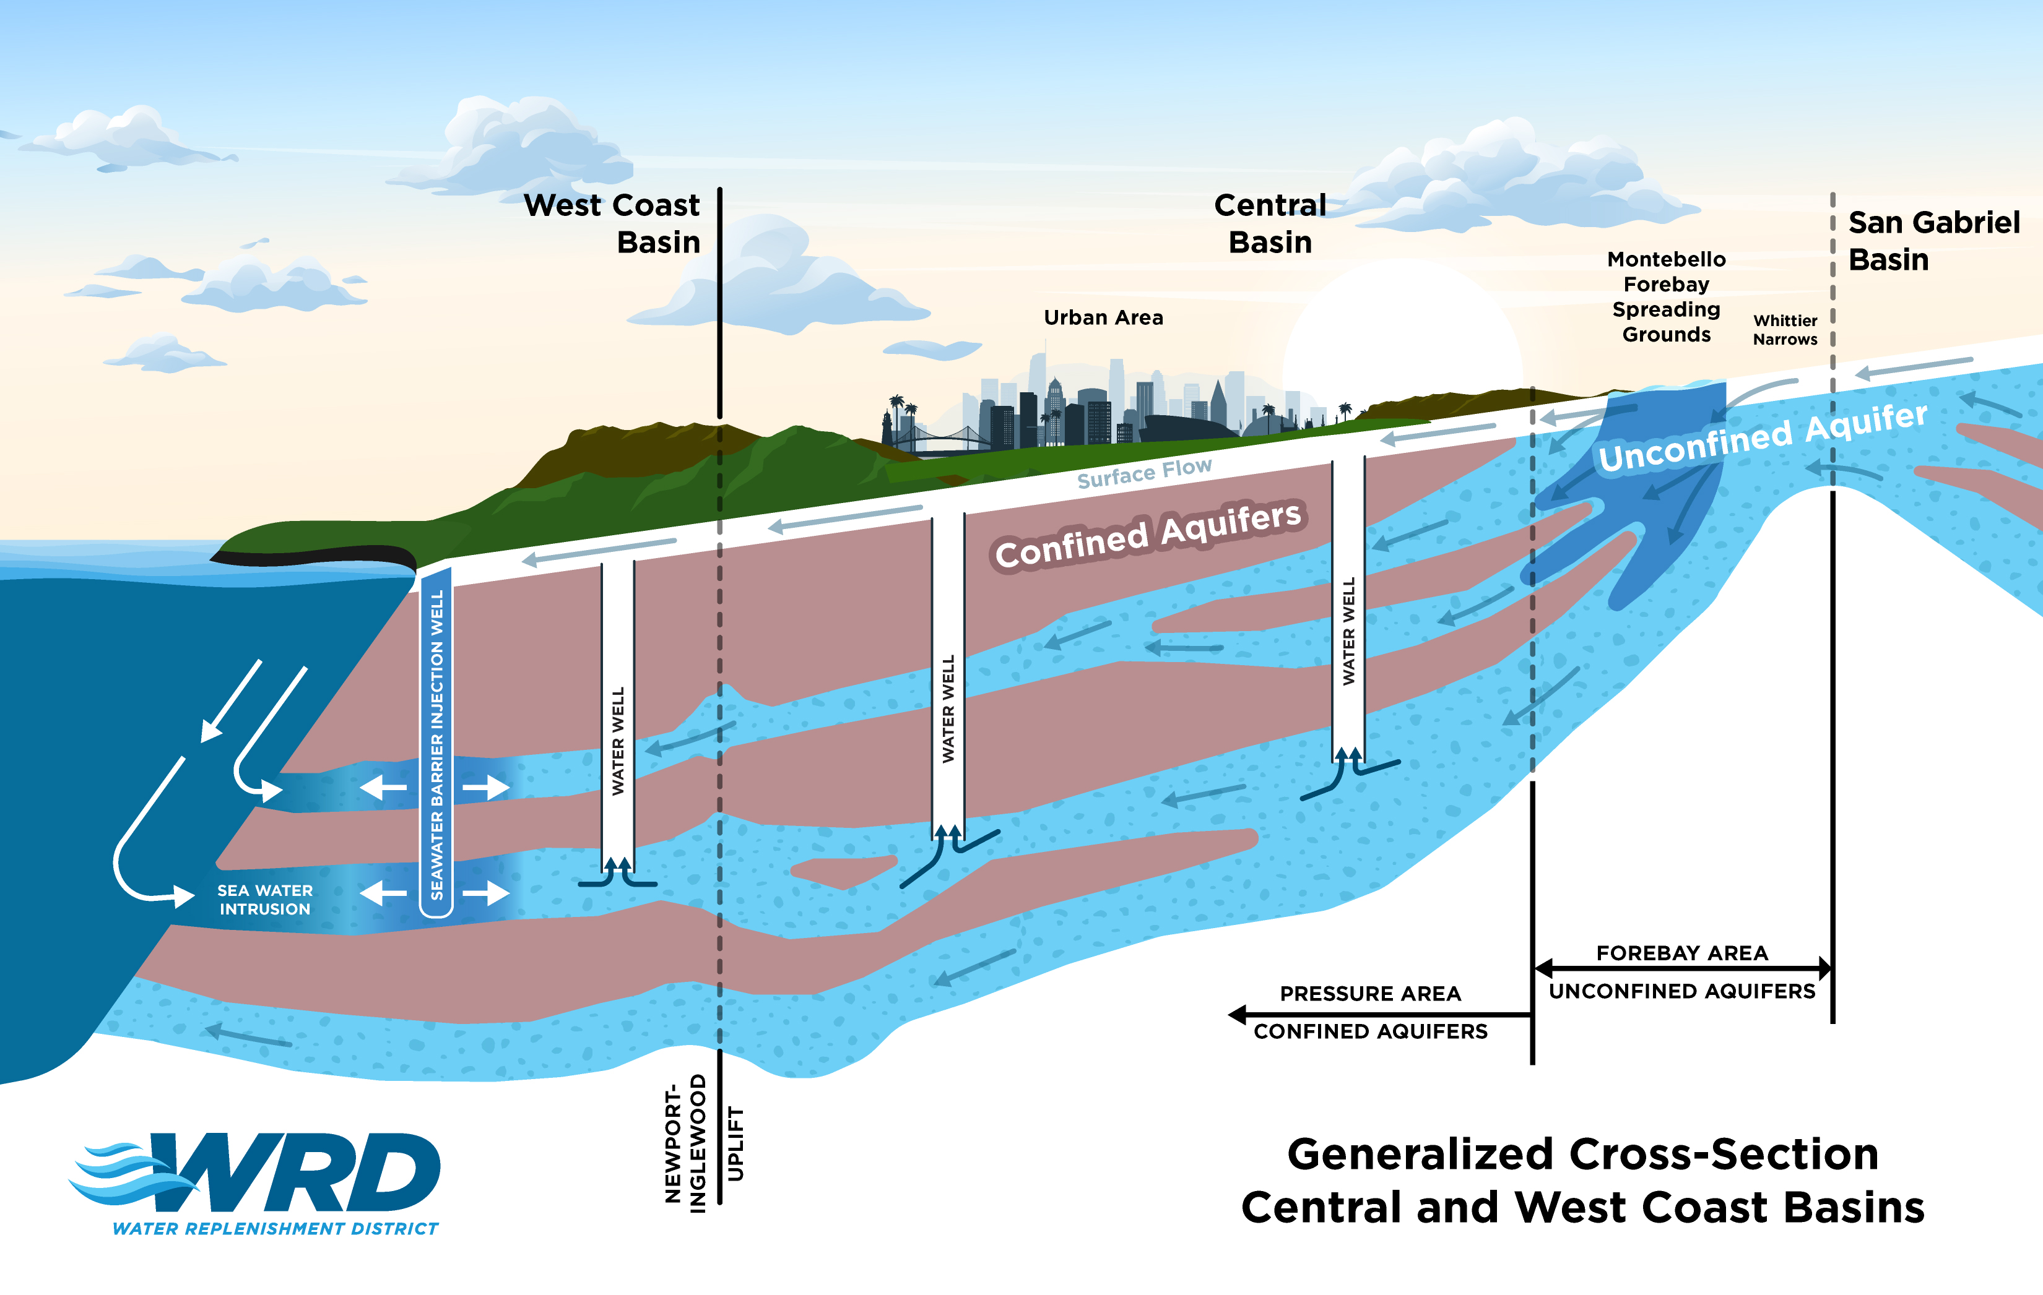
Step 3: Estimate Replenishment, Barriers & Spreading
Notes:
The next step focuses on the water we purchase to artificially replenish the groundwater basin…
The two main areas are shown in the dash squares:
On the left, we purchase water placed in the barriers…
On the right, we purchase water placed in the spreading grounds…

Slide 15
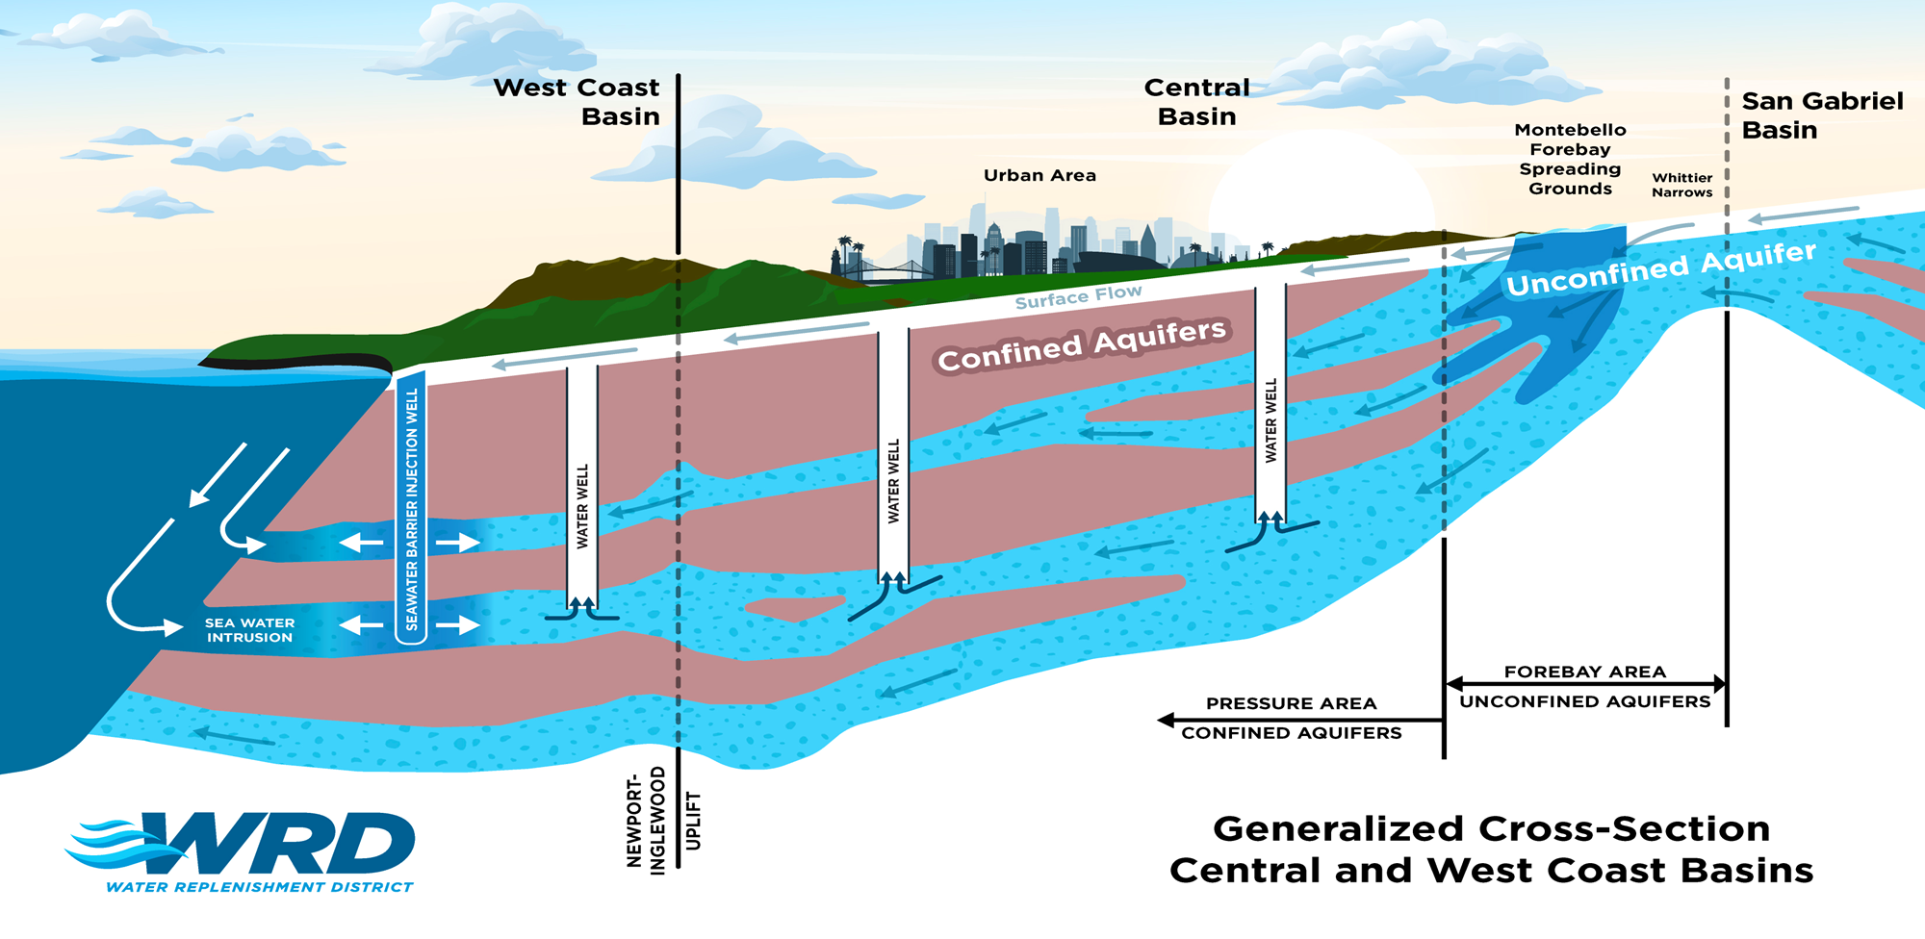
Step 3: Estimate Replenishment, Spreading
Notes:
Let's first talk about spreading…

Slide 16
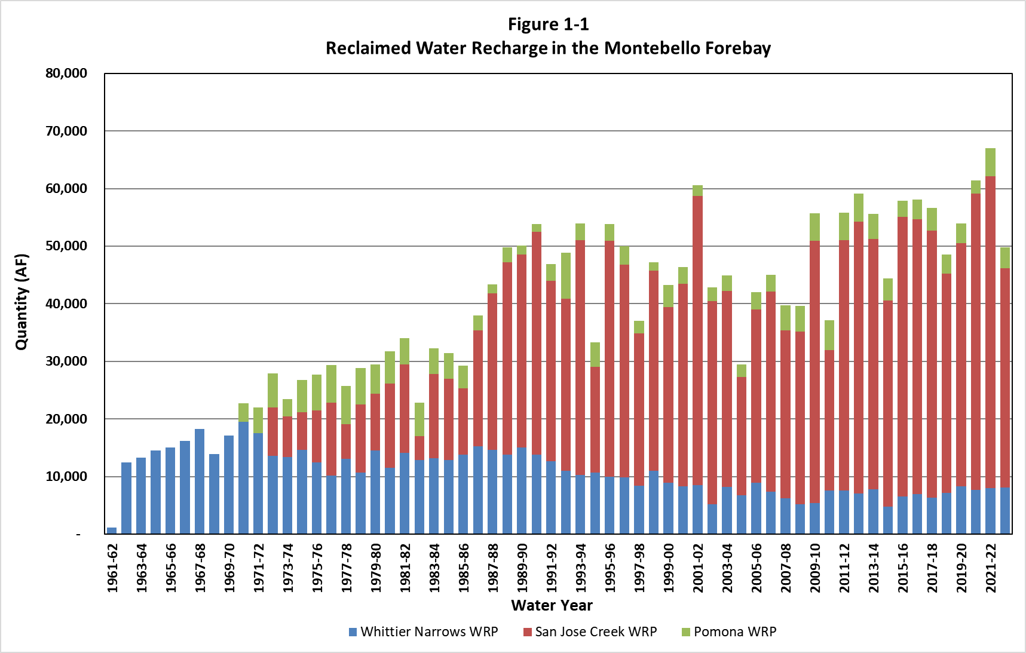
Step 3: Estimate Replenishment, Spreading Volume
Recycled water is consistently spread in the Montebello Forebay (MFB).
Basin storage change is mostly in MFB. Past year it was ~90%.
Largest purchase by volume, FY27 melded cost is $144 / AF. We buy all we can from LACSD.
Previous year totals very close to projection for recycled water (within 0.1%) and advanced treated water (within 4.3%).
Not expecting any significant changes for Current Year and Ensuing Year.
FY27 estimate is 64,000 AF.
Notes:
READ BULLETS…
For FY27, we’re estimating that we will purchase about 64,000 AF for replenishment into the MFB.

Slide 17
Step 3: Estimate Replenishment, Barriers
Notes:
Now, let's talk about the barriers…

Slide 18
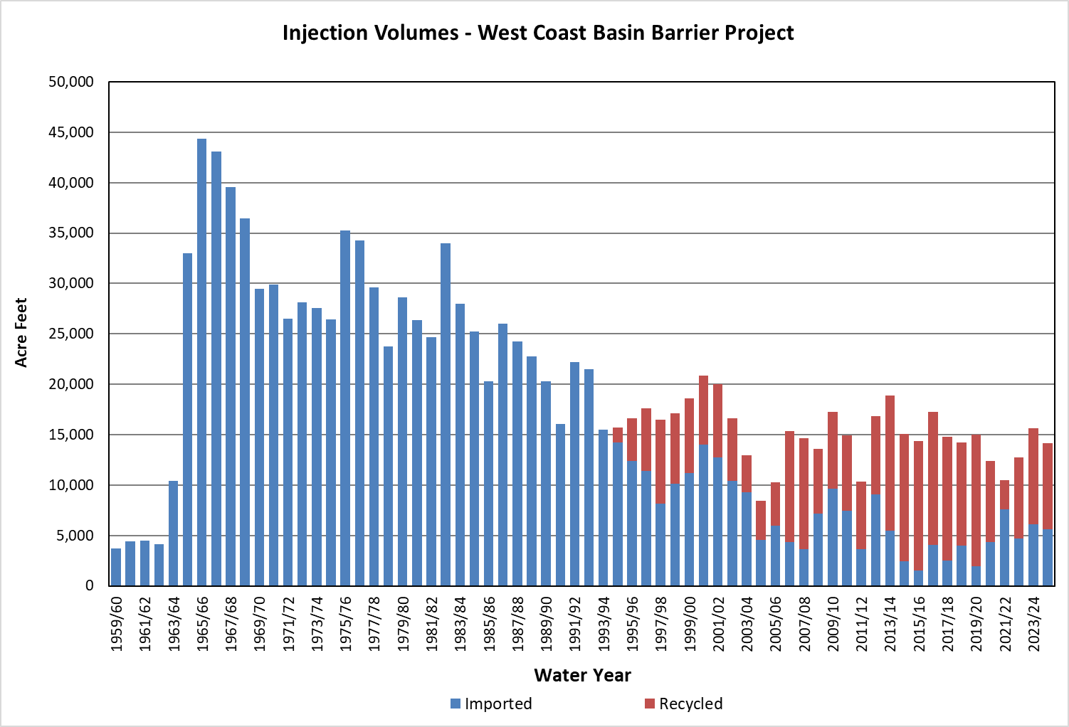
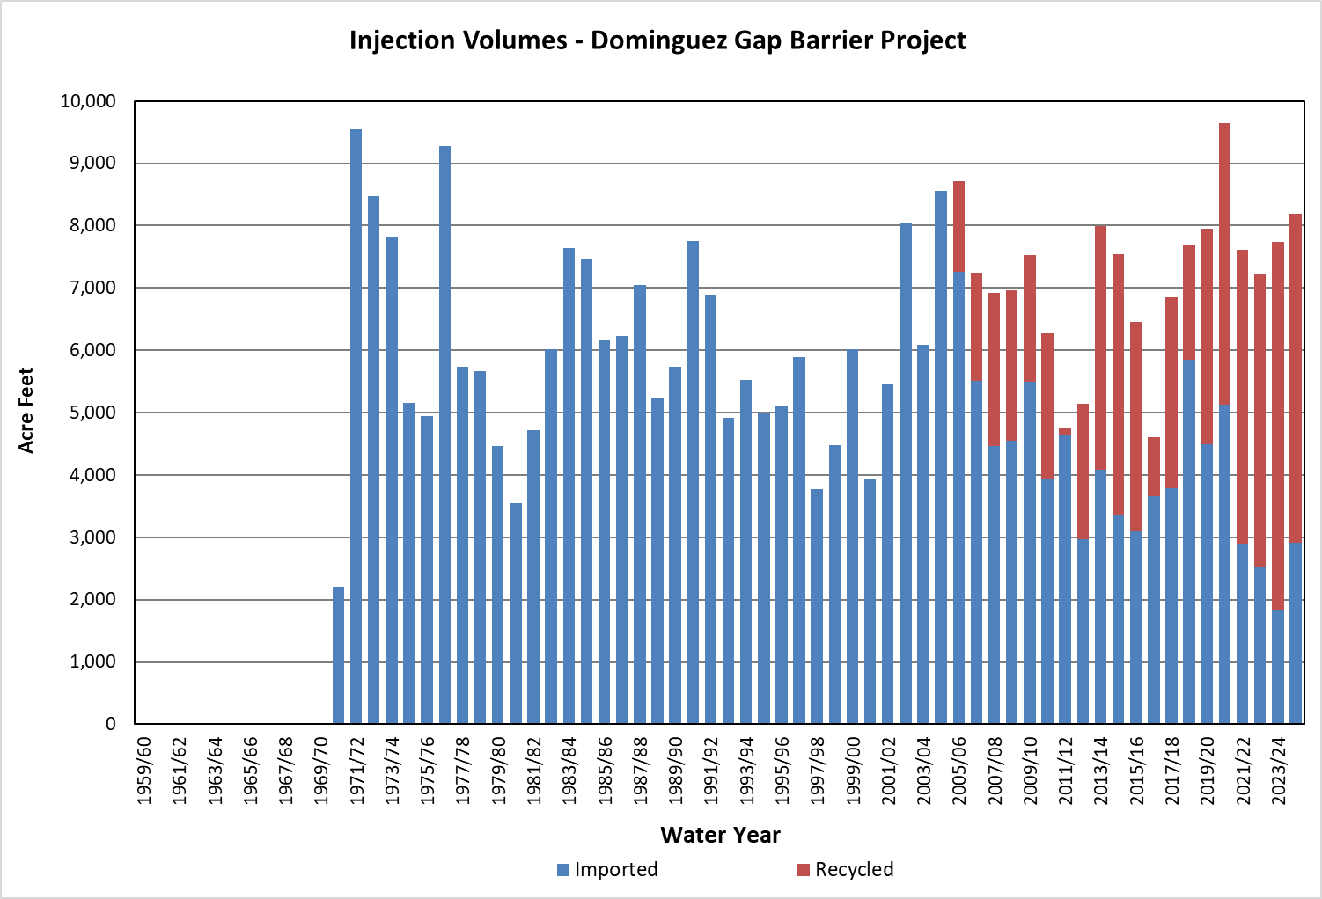
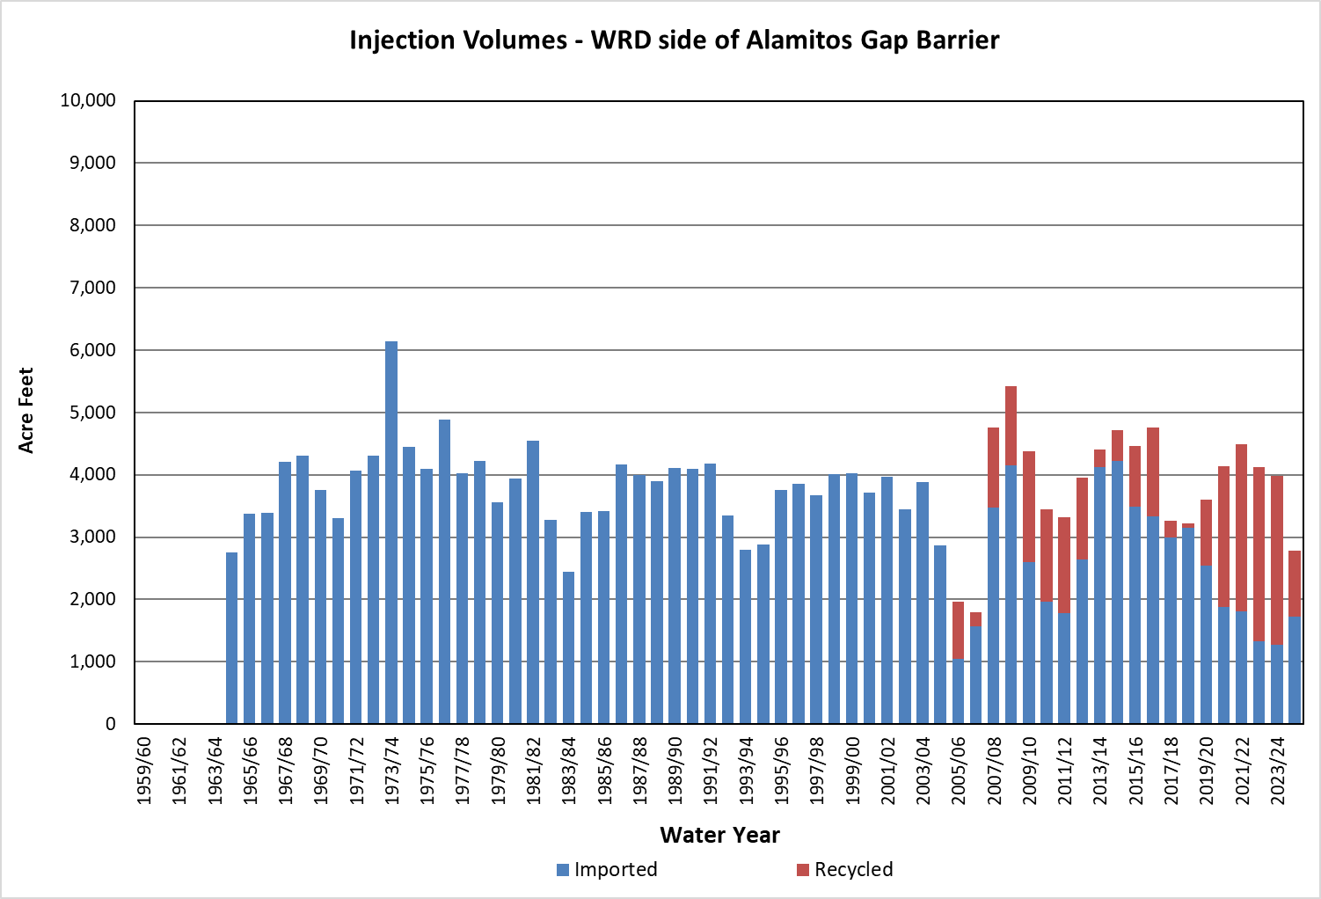
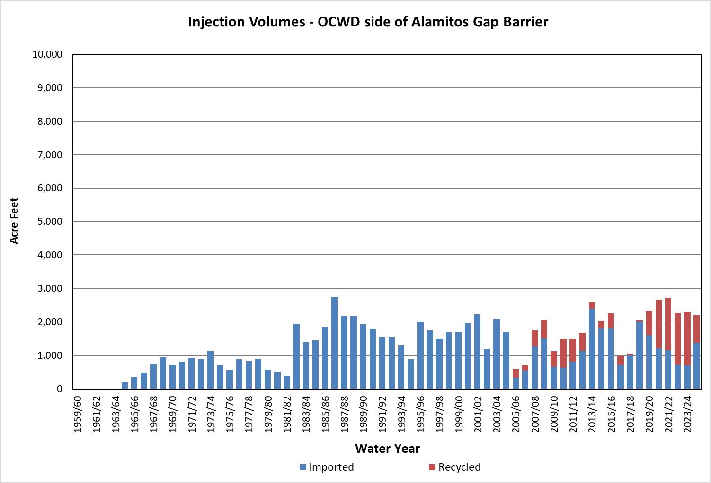
Step 3: Estimate Replenishment, Barrier Volume
Estimate primarily based on recent averages, roughly 4-5 yr.
Some unforeseen issues (line breaks) can skew averages, so our estimates are ground-truthed with operations staff (WRD & LACPW).
Main goal in operating barriers is to maintain protective elevations to prevent Seawater Intrusion.
No major change but we’re projecting an increased use of recycled water (ABP & WCBBP).
FY27 estimate is 26,200 AF.
West Coast Barrier
Dominguez Barrier
Alamitos Barrier - WRD
Alamitos Barrier - OCWD
Notes:
READ BULLETS…
For FY27, we’re estimating that we will purchase about 26,200 AF for replenishment into the Barriers.

Slide 19
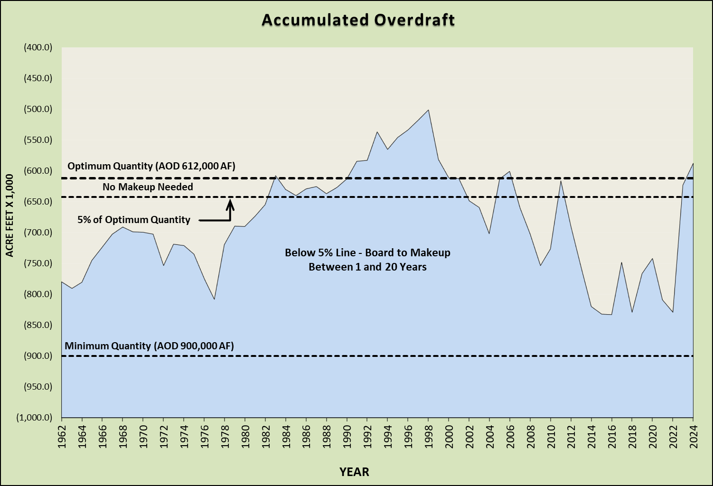
Step 4: Accumulated Overdraft, Currently Under Review
It was extremely dry last year (Rain = 4.52”). Expecting significant drop in Basin Storage.
Notes:
As mentioned earlier, we’re still working through the evaluation, but for discussion's sake here’s last years Accumulated Overdraft.
After a couple anomalous back-to-back wet years, last years rainfall was extremely dry at 4.52”.
This will likely lead to a significant drop in storage and mostly likely below the 5% of Optimum Quantity Line.
FYI…those two back-to-back years have never happened in the historic record – confirmed with LACPW

Slide 20
Step 5: Replenishment Cost Estimate, Sneak Peak at Rates
Similar volume as last year (+800 AF), rate increase is mainly due to higher costs passed down by MWD.
Notes:
And finally, here’s a comparison of the rates we pay to purchase water by location and type – FY26 & FY27.
We plan to purchase a similar volume as last year, +800 AF. That’s not a big difference…
Thus, you can clearly see the rate increase is mainly due to higher costs passed down by MWD.

Slide 21
Step 5: Replenishment Cost Estimate, Sneak Peak at Rates
Notes:
And its only going up…here’s the projections reported by MWD.

Slide 22
Key dates and actions associated with preparing ESR
DECEMBER
Making requests from various stakeholders and processing data for Previous Year.
Estimates for Current Year and Ensuing Year.
JANUARY
Discuss preliminary results with GM / AGM.
Meetings are scheduled to discuss results with our Board and WPAC.
Prepare draft ESR.
FEBRUARY
Board orders staff to prepare the ESR (On or before 2nd Tues.).
Continue discussing results and preparing ESR.
MARCH
Board receives ESR & Declares need for RA. (On or before 2nd Tues.).
Publish Notice of Public Hearing in Paper.
Publish initial ESR.
APRIL
Open Public Hearing (On 2nd Tues.*).
Wrapping up discussions with WPAC and drafting staff proposal for our Board.
MAY
Close Public Hearing (On or before 1st Tues.).
Board adopts RA. (On or before 2nd Tues.).
Incorporate board decision into final ESR (generally posted in June).
* - Although dates specified in the Water Code refer to 'on or before' certain Tuesdays, Section 60043 "Alternative Day" states that "Whenever any act is required to be done or proceeding taken on or set for a particular day or day of the week in any month, the act may be done or proceeding set for and acted upon a day of the month otherwise specified for a regular meeting of the board."
Notes:
And lastly, here are the key dates and actions associated with preparing the ESR.
READ BULLETS…

Slide 23
Key dates and actions associated with preparing ESR
Here’s the schedule for preparing the 2026 ESR…
* - Although dates specified in the Water Code refer to 'on or before' certain Tuesdays, Section 60043 "Alternative Day" states that "Whenever any act is required to be done or proceeding taken on or set for a particular day or day of the week in any month, the act may be done or proceeding set for and acted upon a day of the month otherwise specified for a regular meeting of the board."
Notes:
And the proposed dates…RA adoption is planned for April 21st.

Slide 24
THANK YOU

Slide 25
ESR Requirements Listed
in the Water Code

Slide 26
Water Code Requirements for Preparing ESR
60300. Not later than the second Tuesday in February each year the board shall order an engineering survey and report to be made regarding the ground water supplies of the district. The same shall include, among all other information and data which the board may require, the following:
(1) Records, data and other information for the consideration of the board in its determination of the annual overdraft;
(2) Records, data and other information for the consideration of the board in its determination of the accumulated overdraft as of the last day of the preceding water year;
(3) A report, with supporting data, as to the total production of ground water from the ground water supplies within the replenishment district during the preceding water year;
(4) A report, with supporting data, as to the changes during the preceding water year in the pressure levels or piezometric heights of the ground water contained within pressure-level areas of the replenishment district, and as to the effects thereof upon the ground water supplies within such replenishment district;
(5) An estimate of the annual overdraft for the current water year and for the ensuing water year;
(6) An estimate of the accumulated overdraft as of the last day of the current water year;
(7) An estimate of the total production of ground water from the ground water supplies within the replenishment district for the current water year and for the ensuing water year;
(8) An estimate of the changes during the current water year in the pressure levels or piezometric heights of the ground water contained within pressure-level areas of the replenishment district, and of the effects thereof upon the ground water supplies within such replenishment district;
(9) An estimate of the quantity, source, and cost of water available for replenishment of the ground water supplies during the ensuing water year under the provisions of Section 60315.

Slide 27
Water Code Requirements for Preparing ESR (Cont.)
60315. Upon completing the hearing, but no later than the second Tuesday in May, the board shall, by resolution, find all of the following:
(a) The annual overdraft for the preceding water year.
(b) The estimated annual overdraft for the current water year.
(c) The estimated annual overdraft for the ensuing water year.
(d) The accumulated overdraft as of the last day of the preceding water year.
(e) The estimated accumulated overdraft as of the last day of the current water year.
(f) The total production of groundwater from the groundwater supplies within the district during the preceding water year.
(g) The estimated total production of groundwater from the groundwater supplies within the district for the current water year.
(h) The estimated total production of groundwater from the groundwater supplies within the district for the ensuing water year.
(i) The changes during the preceding water year in the pressure levels or piezometric heights of the groundwater contained within pressure-level areas of the district, and the effects thereof upon the groundwater supplies within the district.
(j) The estimated changes during the current water year in the pressure levels or piezometric heights of the groundwater contained within pressure-level areas of the district, and the estimated effects thereof upon the groundwater supplies within the district.
(k) The quantity of water that should be purchased for the replenishment of the groundwater supplies of the district during the ensuing water year.
(l) The source and estimated cost of water available for the replenishment.

Slide 28
Water Code Requirements for Preparing ESR (Cont.)
(m) The estimated costs of replenishing the groundwater supplies with the water so purchased.
(n) The estimated costs of purchasing, in water years succeeding the ensuing water year, that portion of the quantity of water which should be purchased for the replenishment of the groundwater supplies of the district during the ensuing water year, but which is estimated to be unavailable for purchase during the ensuing water year; estimated costs shall be based on the estimated price of water for replenishment purposes during the ensuing water year.
(o) The estimated rate of the replenishment assessment required to be levied upon the production of groundwater from the groundwater supplies within the district during the ensuing fiscal year for the purposes of accomplishing the replenishment and providing a reserve fund to purchase in future years, when available, that portion of the quantity of water which should be purchased for the replenishment of the groundwater supplies of the district during the ensuing water year, but which is estimated to be unavailable for purchase during that ensuing water year.
(p) Whether any contaminants should be removed from groundwater supplies during the ensuing fiscal year, and whether any other actions under Section 60224 should be undertaken during the ensuing fiscal year, the estimated costs thereof, and the estimated additional rate of replenishment assessment required to be levied upon the production of groundwater from the groundwater supplies within the district during the ensuing fiscal year for those purposes.
(q) Whether any program for removal of contaminants or other actions under Section 60224 should be a multiyear program or is a continuation of a previously authorized multiyear program.

